Slide 1
Mental Health and emotional wellbeing
Mrs Barlow – Designated safeguarding lead
Miss sherriff – head of year

Slide 2
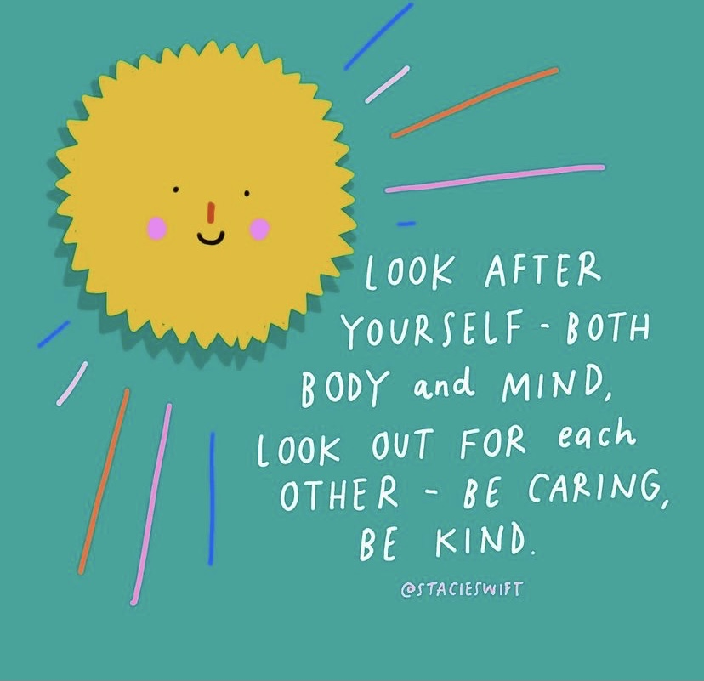
Surviving or thriving – Where are you at?
Check in with yourself
How are you feeling lately?
Is something bothering you?
How are your energy levels?
Have you been getting enough sleep?
What did you do yesterday that made you feel good?
How are your physical activity levels?
Have you been eating properly?

Slide 3
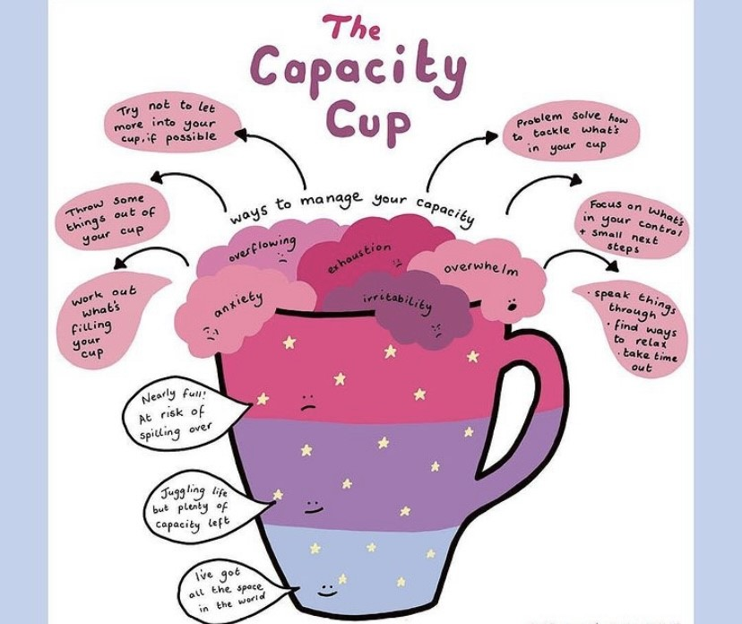
Self care Plan this into your revision schedule
Exercise
Journalling
Listen to music
Speak to friends/family
Enjoy time outdoors
Watch a favourite show or film
Have some device free time
Have a bath/shower

Slide 4
Revision and exam stress
Anxiety and stress are a normal, if unpleasant, part of life. These feelings can feel a little overwhelming at times, especially when it comes to exams and dealing with revision. This is why is really important to look after yourself as much as you can.
In dealing with issues around revision, exams and stress, remember not to suffer in silence. Coursework, revision and exam pressures are very common issues for young people so you are not alone.
Consider sitting down with your Head of Year, Form Tutor or teacher and tell them how you’re feeling. Our role is not to put pressure on students, but to provide support so that you can do your best
It’s also important for you to talk to your parents, close family or friends about what’s going on so they can understand and appreciate how you are feeling and offer their own support.

Slide 5
Tips from students
Find a balance - The most important thing is to use your time wisely, and find a balance between revising and spending time doing the things you enjoy. Constantly revising without a break can make you feel emotionally and physically drained, so it’s crucial that you take time to step back and do something that you enjoy. Whether it’s a hobby, or getting some rest, it can help you to recharge. It also lets your brain digest what you’ve just revised, instead of cramming lots of information in at once.
Stay in touch with friends - Another thing that can help mental health while revising is staying in regular contact with my friends. You may find that talking to my friends about revision and the anxiety of what’s to come, reminds you that I’m not alone. Often friends are feeling the same nervous feelings, which are completely normal to have when preparing for exams. It may also be helpful to arrange time to revise together.

Slide 6
Tips from students
Be organised – Many young people struggle with stress whilst revising for GCSEs. This is mainly down to the fact that they don’t set a plan of what they needed to revise. It can become a big mess and the stress of not knowing where to start triggers more problems with mental health
You may find that stress can affect you both physically and mentally. Try creating a plan of what you need to do, or put each subject in order of what you need to revise first, to eliminate some of the stress that can cloud your mind. Being organised can help you approach your revision in a manageable way, and helps if you find yourself crumbling under stress.

Slide 7
Tips from students
Separate where you rest and revise - When revising for GCSEs, It can make it difficult when you blend the places of revision and rest. If you do a lot of revision in your bedroom, it can be hard to get away from revision when you want to rest or sleep – everywhere you look there are papers and flashcards looming over you.
Instead of resting when you need to, you may get anxious about not using this time to revise. So you could choose to revise in a different place or tidy up when it is time to rest. This will help you to escape when you walk into the private space of your bedroom.

Slide 8
How can you support your child?
Have open lines of communication, talk about their day and allow them to offload, when needed
Chatting to share vs chatting to problem solve
Support them to check Satchel One, encourage them to check off everything they need the night before, to avoid stress in the morning
Discuss responsible use of social media and mobile devices. Monitor usage, don’t be afraid to check what they are doing and who they are speaking with!
Understand the apps they are using, place parental controls on their devices
Use Parental Controls to Keep Your Child Safe | NSPCC

Slide 9
Support in school
Mr Hampton – Head of Year/Mental Health First Aider
Miss Sherriff and Y11 tutor team
Mrs Barlow – Designated Senior Lead Mental Health
Mrs Harrison – Designated Safeguarding Lead
Mrs Maycock – Designated Safeguarding Lead
Mental Health First Aiders
Mr Hampton
Mrs Furniss
Mrs Pipes
Miss Douse
Ms Cortez Lopez
Miss Campbell
Miss Grace

Slide 10
Support Through school
Pastoral support
Mental Health First Aiders (7 members of staff)
School Counsellor
School Health
Building Sound Minds (Action for Children)

Slide 11
Social media and websites
Young Minds
Anti-bullying Pro
Kooth
Derbyshire LGBT+ /Stonewall
School website (Mental health and wellbeing section)
Calm Harm (App for self harm)
Think Ninja (NHS app for stress/anxiety)

Slide 12
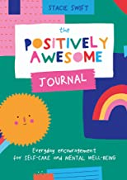
Useful books

Slide 13
#kindtoyourmind
“If it still bothers you after 24 hours, speak up within 48 hours”

