Slide 1
Welcome to the……

Slide 2
Using Apps and interactive websites to tackle JF’s 5 most common ‘student study struggles’
“I don’t know how to revise”
“I keep forgetting everything”
“I don’t get it”
“I get bored of doing the same thing”
“I can’t answer exam questions”
Five
‘Student Study Struggles’:

Slide 3
Problem: “I don’t know how to revise”
Solution: Use apps to help you choose a few methods that work for you
Good for:
Visuals & Overviews
Pinterest and Padlet allow you to collect and ‘scrapbook’ ideas. They are filled with revision notes, diagrams and visuals shared by schools and learners.
Miss Teal’s Top Tips:
Limit time to avoid ‘drift’
Know what you’re searching for
Be specific
This is not revision, this is preparation for revision and organisation

Slide 4
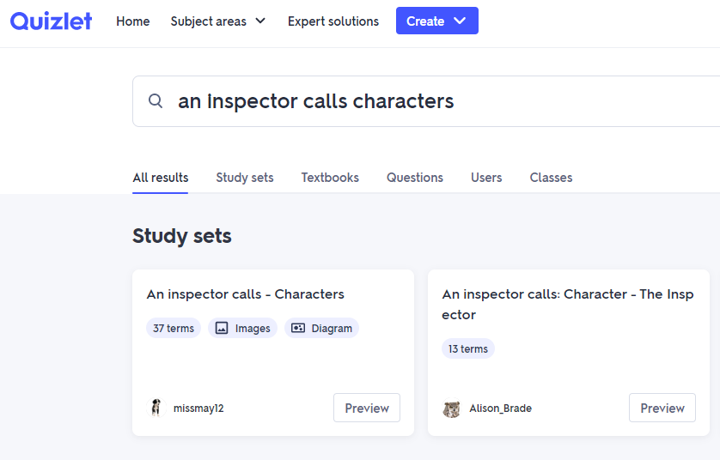
Problem: “I keep forgetting everything”
Solution: Revisit information LOTS and test yourself!
Good for:
Subject Knowledge
Quizlet, Seneca and Tassomai allow you to revise and test subject knowledge.
Quizlet, for example, contains pre-made flashcards, multiple choice quizzes and true/false style questions.
Miss Teal’s Top Tips:
Find one or two Apps that cover multiple subjects.
Check the content is right for your course.
Couple this method of revision with other robust methods of revision e.g. revision guides

Slide 5
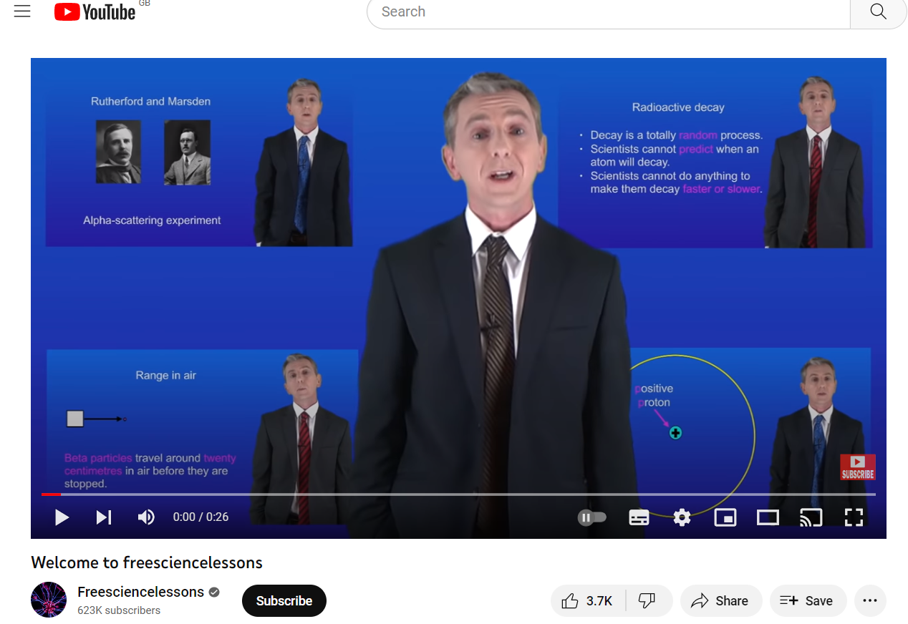
Good for:
Solidifying Understanding
Problem: “I don’t get it”
Solution: Revisit at your own pace
YouTube can be very useful to help develop and solidify understanding of subject knowledge.
You can pause and rewind (or even fast forward) to ensure learning is happening at a pace you’re comfortable with
Miss Teal’s Top Tips:
Search ‘GCSE’ after the subject content you want to see to ensure it is pitched at the right level
Add your exam board into the search field for specification-specific content

Slide 6
Problem: “I get bored of doing the same thing”
Solution: Keep your revision varied
Why are these useful?
These are all great for developing subject knowledge and practicing recall. As a result, using such websites and Apps are good for highlighting gaps in subject knowledge. This means they should be used as a starting point from which you can dig deeper.
They are convenient. Revision and practice can be done on a tablet or smart phone and their design allows you to ‘dip in and out’ when you have the time.
The interactive nature means they provide instant feedback on quizzes and tests.

Slide 7
Problem: “I can’t answer exam questions”
Solution: Ensure your subject knowledge is secure and then practice them
Past Paper Questions:
Good For Deepening Learning
The most valuable resource!
Gold dust!
ONLY use once you have secured knowledge on a topic – don’t waste them!

Slide 8
Each of our students is going to give you a two minute whirlwind tour of a different app.
Becky – “I don’t know how to revise”: Pinterest – gather a selection of revision strategies
Katie – “I keep forgetting everything”: Tassomai – test your recall
Lola – “I don’t get it”: YouTube (GCSE exam board specific) – relearn content at your own pace
Ryan – “I get bored of doing the same thing”: Quizlet – a variety of ways to test yourself
Millie– “I can’t answer exam questions”: Past paper websites – useful for application, once knowledge and understanding are embedded

