Slide 1
Welcome to ‘Reading for Pleasure and Research’…

Slide 2
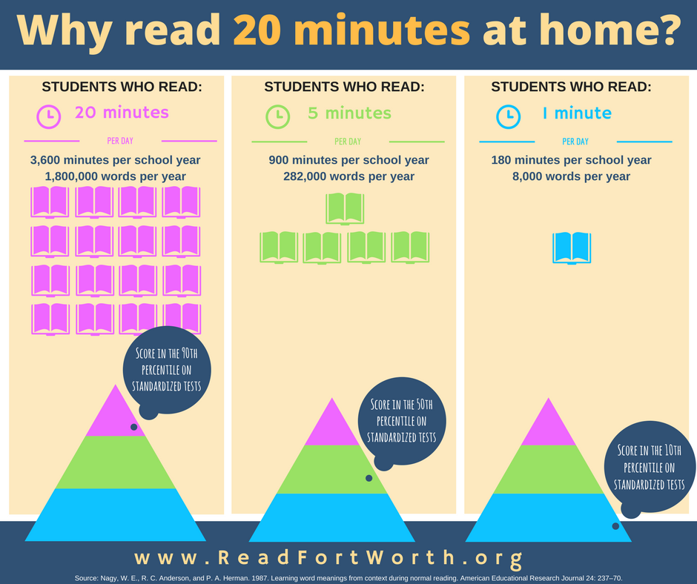
What does the research say?
Reading enjoyment has been reported as more important for children’s educational success than their family’s socio-economic status (OECD, 2002).
Through independent reading children gain a wealth of background knowledge about many different things, come to understand story and non-fiction structures, absorb the essentials of English grammar, and continuously expand their vocabularies” (Strauss, 2020).
A new study found that people who read books for 30 minutes a day lived longer than those who didn’t read at all.

Slide 3
Why read for pleasure?
A way to wind down from revision/exam stress.
Research shows that reading before bed leads to improved quality of sleep.
Improves breadth of vocabulary, comprehension and greater self-confidence as a reader.
A greater insight into human nature and decision making.
Improves writing ability.
We are AMBITIOUS
We choose books that will challenge us.
We are COMMITTED
We read for at least 30 minutes a day.
We are PROUD
We know that we have tried hard
and persevered.

Slide 4
Should I make the time to read when I have exams?
Yes!
Escapism
Chance to pause reality and take a well-earned break from the stresses of Y11.
Reading can be of absolutely anything: magazines, blogs, instructions, recipes, fiction, non-fiction.
Single biggest indicator of future success.
We are AMBITIOUS
We choose books that will challenge us.
We are COMMITTED
We read for at least 30 minutes a day.
We are PROUD
We know that we have tried hard
and persevered.

Slide 5
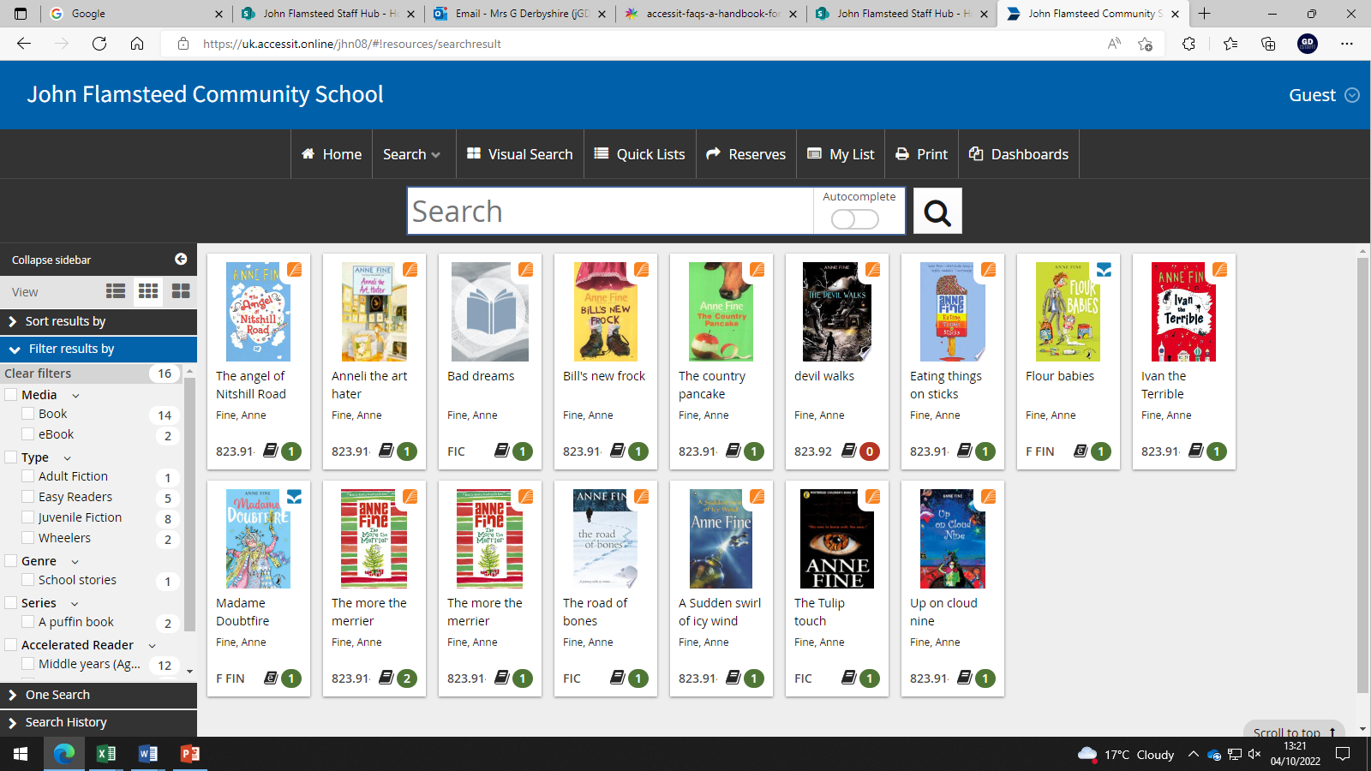
Access It:
Our online library system, “Access It”, makes reading on a laptop, iPad or phone so much easier and more portable. The site can be found on the School Hub, with a student’s normal log-in details, and provides eBooks, audio books, information and quizzes.

Slide 6
Reading for research: Jstor
JSTOR provides access to more than 12 million academic journal articles, books, and primary sources in 75 disciplines.
They help you explore a wide range of scholarly content consisting of a wide range of research. They collaborate with the academic community to help students connect with vital scholarly content while lowering costs, providing independent researchers with free and low-cost access to scholarship, and helping publishers reach new audiences and preserve their content for future generations.
Academic reading represents the cutting edge of research and study, it places you at the forefront of your subjects.

Slide 8
Why read for research?
2008 University of Nottingham study found that of 3,400 students reaching higher education, 67% were confident with academic reading prior to attending university.
2016 Harvard University study found that students starting academic reading earlier in their education (high school in America) were more confident in challenging ideas.
1998 study with the open university found that academic readers at KS4 and A level reported higher levels of “work place confidence” than non-readers.
Good practice for future learning, whether apprenticeship, A Levels or work based learning.

Slide 9
Transferable skills:
Independent study makes you a better organiser and a more efficient worker.
Interacting with challenging content develops your ability to adapt.
Confidence in discussing your subjects will increase.
Any advanced reading develops your subject specific vocabulary and understanding.
The attitude of “I’ll lead the way” rather than “I need to be lead.”

Slide 10
Thank you. Do you have any questions?
Notes:
Ask parents to view Access It on the computers. Have KS4 reading material available for viewing.

