Slide 2
Let’s get talking:
Adults – Reflecting on the most recent time you have had to study for something, what worked well for you? Share this with your children.
What wouldn’t work well for you or what challenges might you face?

Slide 3
Let’s get talking & writing:
Families – On your post-it note, list all the methods of revision/ways to revise that you can think of.

Slide 4
What did you come up with?
Mind Maps Flash Cards
Social Media Revision Guides
Past Papers Online Programs (??)
Post-it notes Posters
YouTube clips Mnemonics
Voice Recordings Podcasts

Slide 5
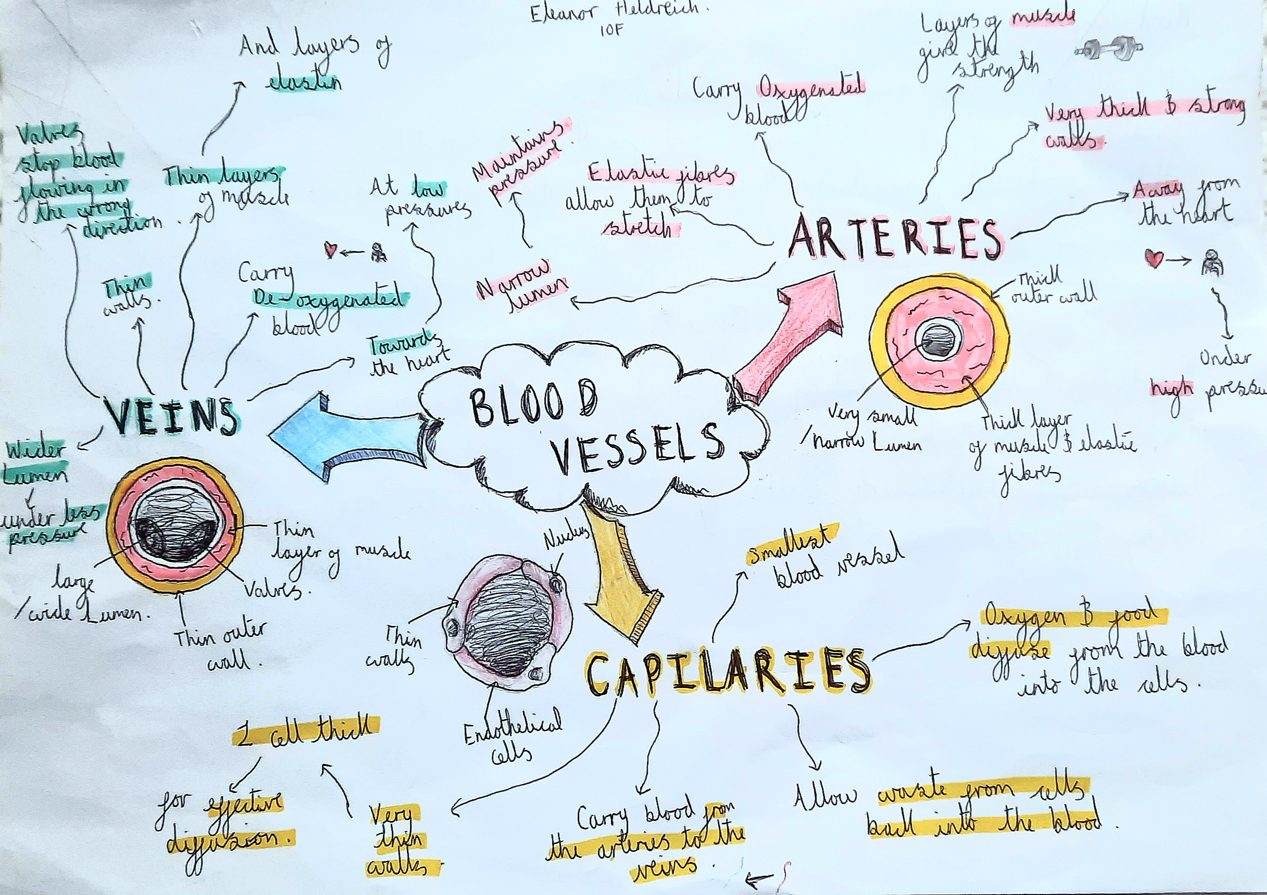
Mind Maps
Example of a mind map.
Science.
Blood Vessels

Slide 6
Mind Maps
Mind maps are very useful and can be used in many ways. For example:
They are great starting points for revision (help to tell you what you do and don’t know).
They can help to build connections and organize particularly complex ideas or concepts (can simplify them for you).
They are also very useful for nearly every type of learner:
People who learn by doing / writing – Creating a mind map can really help.
People who learn by reading / listening – Can read along the arrows or get someone to recite the arrows to you.
People who learn by seeing - Using lots of different colours and diagrams in your mind map really helps to differentiate between the sections and envision it in the test.

Slide 7
Everyone loves an organised person! – “Fail to prepare; prepare to fail”
School/Week Days | Pre-School | Lunchtime | 4pm – 6pm | 6pm - 8pm | 8pm -10pm
Monday
Tuesday
Wednesday
Thursday
Friday
The Weekend | Morning (9am – 12am) | Afternoon (12pm – 4pm) | 4pm – 6pm | 6pm - 8pm | 8pm -10pm
Saturday
Sunday
Walk the dog
Extra Art
Family/me time
History
English
Maths after school
Family/me time
French
Lunchtime with friends
Walk the dog
PE
Sport
Family/me time
Science after school
Extra PE
Walk the dog
Science
Walk the dog
Fish & Chip Friday
Power Nap
Family/me time
Sport
Walk the dog
English
Maths
Family/me time
Walk the dog
Sport (watch and/or do)
French
Family/me time

Slide 8
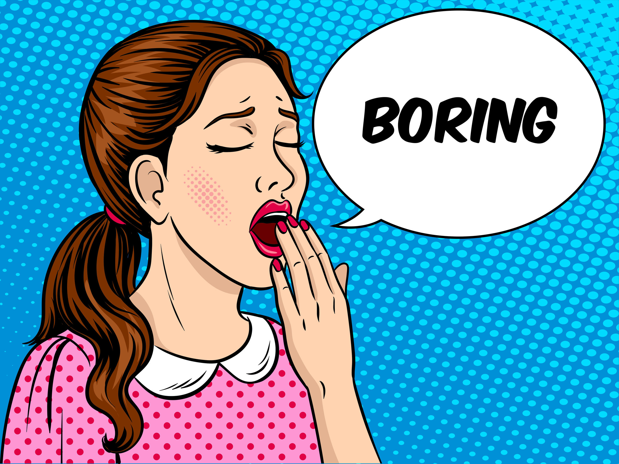
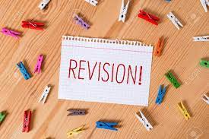
What is revision?
It’s one of the dullest things to do.
… but it has to be done if you want to do well.
At its simplest, it’s repetition.

Slide 9
What’s the best way to revise?
There is no ‘best way’.
The best way is a method or methods that work best for you.
The challenge is finding one!

Slide 10
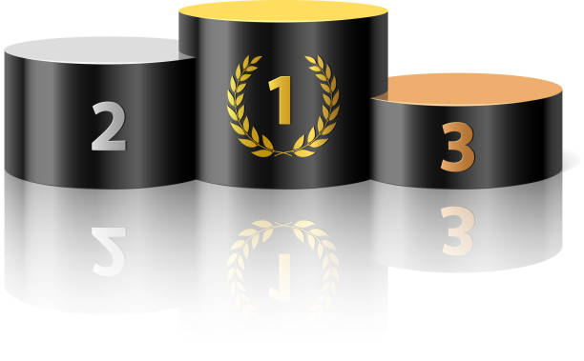
Podium revision questions:
Bronze – How long should I revise for?
Silver – What do I need to revise?
Gold – How do I revise?

Slide 11
Bronze – How long should I revise for?
Unfortunately, there is no straightforward answer.
Some people work better in small chunks. Others prefer to have a long run at it.
Some days revision will flow; other days nothing sticks.

Slide 12
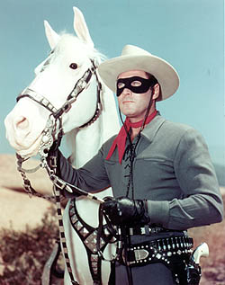
Silver – What do I need to revise?
Ask your teachers. They teach to a syllabus so they will be able to tell you what is available or useful.
Research the topics in the syllabus and work through them.

Slide 13
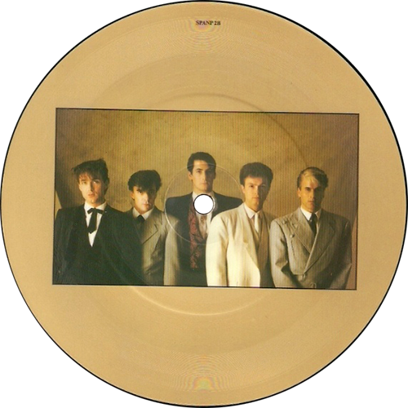
Gold – How do I revise?
Find a way – What method of revision works best for you?
Actively revise – don’t just read your notes.
Breaks – Take them often, especially if nothing is going in.
Distractions – Minimise them.
Environment – You have to be happy & comfortable – Where’s best?

Slide 14
Mr H’s Top Tips:
Create a place to study (quiet, well lit, spacious & comfortable)
Plan your revision (use and re-use the planner you have been given)
Prioritise your subjects
Avoid passive revision; do active revision (make notes)
Revise multiple subjects across one day
Test yourself (or get others to test you)
Become a teacher – teach what you’re learning to others
Do past papers
Repeat, repeat, repeat
Don’t stop doing the things you love doing “All work and no play…”

Slide 15
One word conclusion:
Plan
Notes
Room
Vary
Sleep
Post-Its (hyphens don’t count)
Papers
Punctuality
Context
Believe

