Slide 1
REVISION TIPS from y12

Slide 2
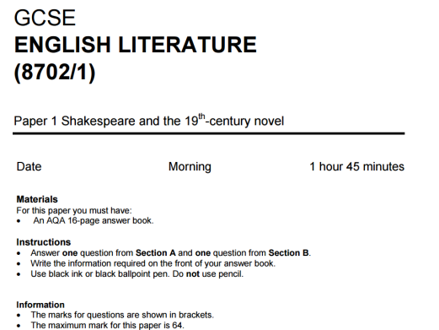
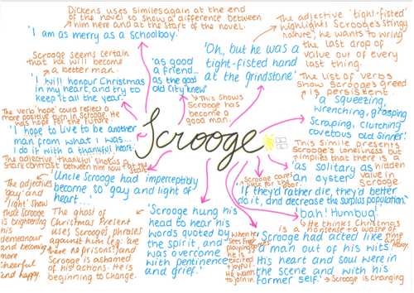
English
Suggested tips for revising English:
Mind-maps (quotes for characters and themes)
Quote flashcards
Past paper exam questions (both language and literature)
All these aided in the ability to learn the structure utilised for each question (especially for language papers) and mind-maps significantly helped for the learning of quotes for literature questions. Past papers helped also with the timings for each question and getting used to using such so by the time exams arrive I alongside others were fully prepared.

Slide 3
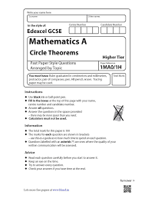
Maths
The main way I revised for maths was the use of past papers provided by school weekly and furthermore online via various websites.
These aid to identify areas of weakness in specific topics e.g. bearings that you can find worksheets on and videos to work on this area for the final GCSE.
Websites such as my maths, Dr Frost, Hegarty maths and Maths and physics tutor also offer past papers that are marked as you go and tasks for targeting areas of weakness.

Slide 4
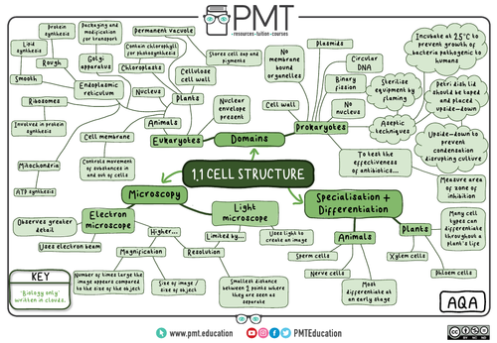
Science
For science, I used:
Flashcards (for key terms, equations and steps for required practical)
Past papers
Mind-maps
Educake (online website for specific areas of science)
Whiteboard blurting
Maths and physics tutor website
These helped to learn what the mark schemes expected for certain questions and the structure of the exam alongside the specific terms and equations needed for the exams.

Slide 5
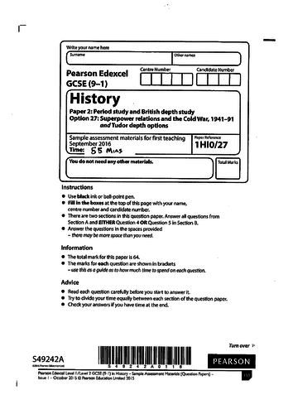
History and Geography
Ways to revise for History include:
Flash cards (detailing specific dates, individuals and terms)
Past papers
mindmaps
quizlet
For essay subjects the best way is to revise is doing practice the actual questions for each paper to get used to the timings and structure. This will also help with knowing the content as you become more comfortable knowing what term or piece of information to use and when.

Slide 6
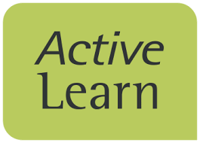
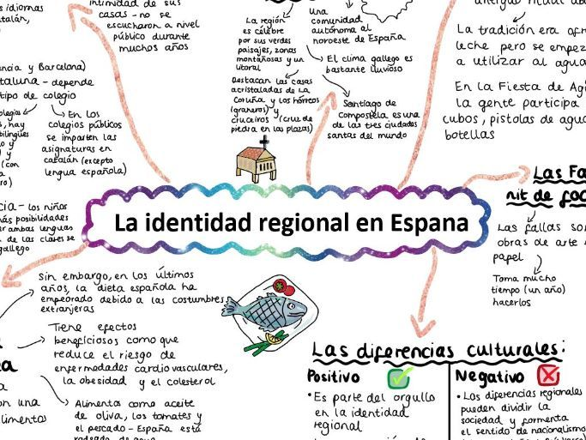
Languages
Flashcards for vocabulary
Practice papers to learn the structure and timings for each
Pearson active learn
Practicing speaking months in advance
The vocabulary and grammar aspects are important for all exam areas of this subject. These can be revised through all of these methods.

Slide 7
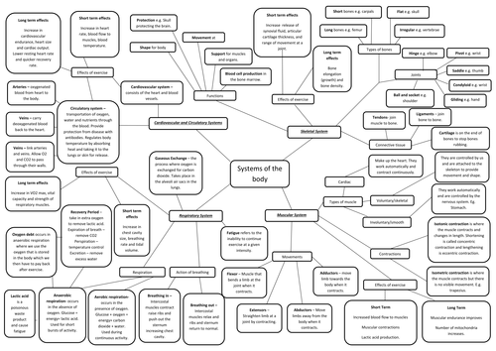
P.E.
Ways to revise for PE :
Mind-maps
Past papers
These helped me to learn the content needed and also practice the structure I would need for the final exam.

Slide 8
Revision help:
Period 6 revision sessions
These were ran by teachers after school from 3.30pm until 4.30pm and gave the ability to go over the weeks’ topics with the aid of teachers. Incentives of biscuits and other treats were provided.
Intervention
Pupils were selected for form time intervention based on our performance in mock exams. This was usually for Maths, English and Science and gave us a last push before our GCSE.

Slide 9
SLT progress meeting
These were meetings with members of the SLT to talk about how we are getting on in lessons, go over mock results and talk about revision strategies that we are implementing at home. They gave further advice on other things to do.
Post 16/ careers advice
These were also meetings with members of SLT to talk about future career options and the GCSEs and A-levels that we would need to do this. It also helped for those who didn’t know what career they wanted or were unsure on the path to take.
Extended study time before exams
The ability for last minute revision before on the day of exams aided for final touch ups in knowledge alongside timings and structure.

Slide 10
Breakfast sessions
These were before and during form on the morning of the exam for final pieces of revision and support from teachers to relax before. Breakfast snacks were provided by teachers as an incentive and good luck for us. These were only available for morning exams.
Drop down days
These days were multiple periods of just being in one subject; this was mainly for core subjects yet were offered over a variety of them such as History. These were extremely helpful for having structured revision and getting the help that we all needed in the final run up to exams. These helped us to feel more confident about the final exam.

Slide 11
Value of independent organisation:
The formation of revision timetables were significantly important and using this to aid in creating a school/social life balance as it is vital that you give yourself time to relax and take a break. Your mental health and reduction of stress is one of the most important aspects to look at during this period. The idea of group study sessions with friends are one way to help create the balance between school and friends.
To manage the workload, starting early is important; start as soon as possible. This way you can cover all content before the exams and reduce the stress over covering it all. Packing your bag the night before is also a good way to feel as calm as possible the morning before an exam as you are not rushing trying to find everything needed for the exam.

Slide 12
How parents can help:
There are a few ways that parents helped us during exam season:
Breakfast prioritised
Providing a quiet study area
Quizzing and supporting active revision
Checking in on stress and emotions
Providing rewards
Prioritising healthy eating and exercise
Getting good quality sleep during exams
Just supporting your children and encouraging them is so important during this time. Take an interest in what they’re doing.

