Slide 2

Do you like…?

Slide 3
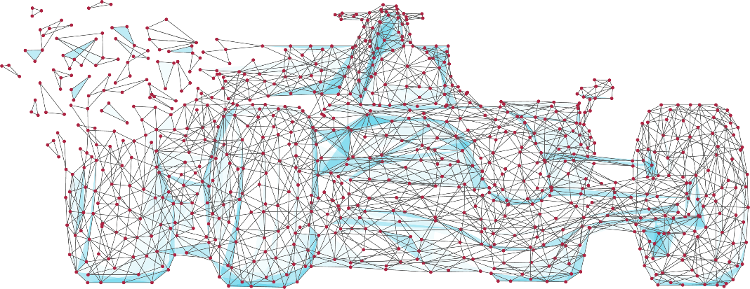
Why choose CS?
Computers are changing every part of our lives at an ever increasing rate – why not drive the future?
In this GCSE:
Experience programming and making new software
Find out how hackers attack computers
Discover how computers work
Solve logical problems

Slide 4
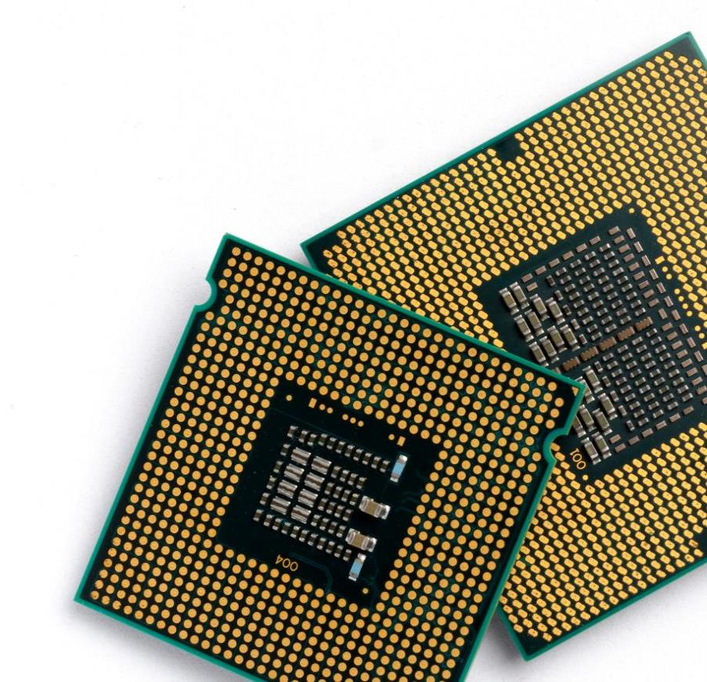
CPU design
The brain of any computer is the CPU
The UK is a world leader of CPU design
Made by ARM, who are based in Cambridge
ARM chips are used in almost all mobile phones including iPhones
Are you the person who will design the next generation of devices?

Slide 5

Drones
Drones are already used for film making, search & rescue and surveying
In the future, deliveries to your house could be made by drone
They will need programmers to tell them where and when to go each day
Would you like to be a part of this future?

Slide 6
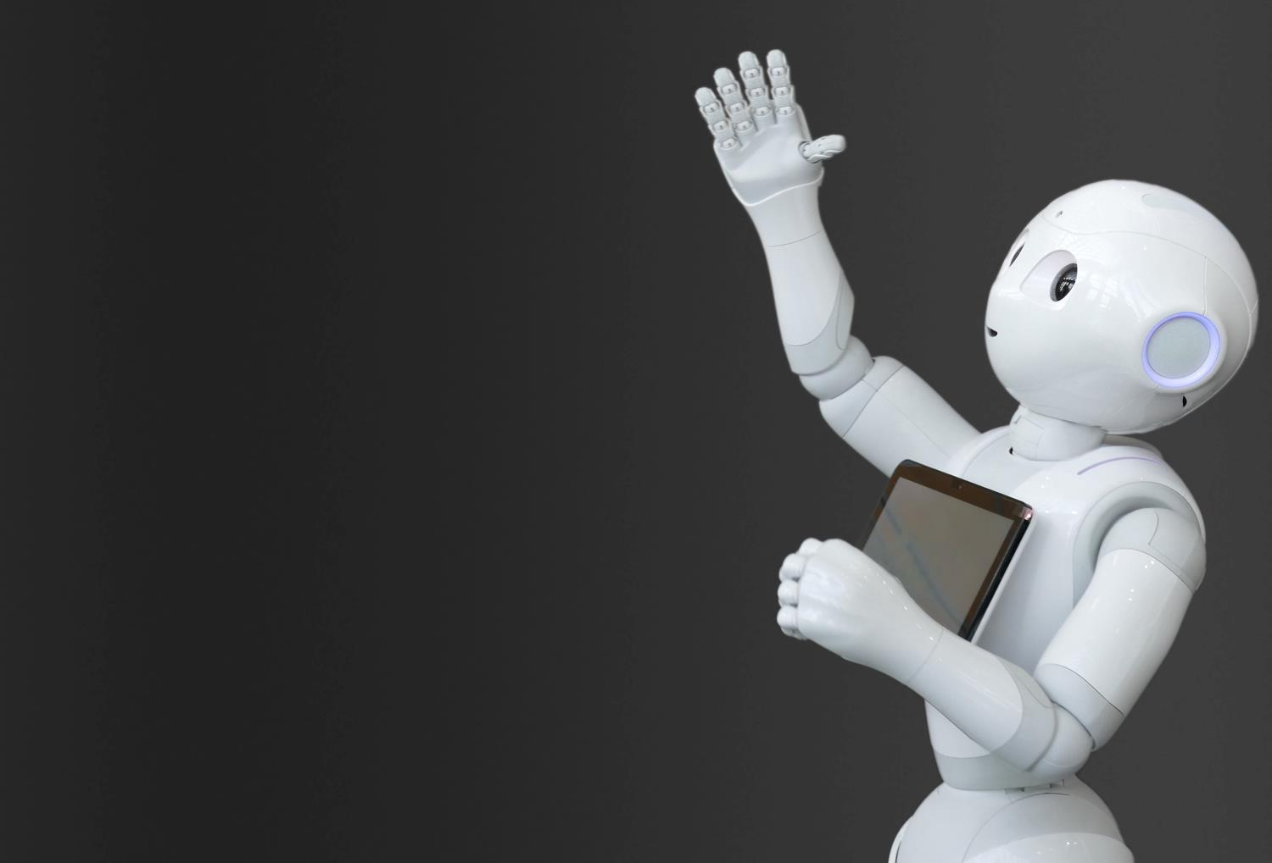
Robotics
We are finding more and more uses for robots
Robotic vacuums in the home
Car assembly
Clearing mines in a war zone
To make a robot you need to have a good understanding of how computers work and how to program them

Slide 7

The World Wide Web
Invented by British scientist, Tim Berners-Lee in 1989
More than four billion people now use it
Over 45 billion web pages have been written
Every British business needs people with an understanding of how computing can help them

Slide 8

Game-changing E-commerce
Shopping has been transformed since the web was invented
Online shopping was worth £1 trillion in 2014
It is predicted to be worth £3.7 trillion by 2021
Want to know how it works?

Slide 9
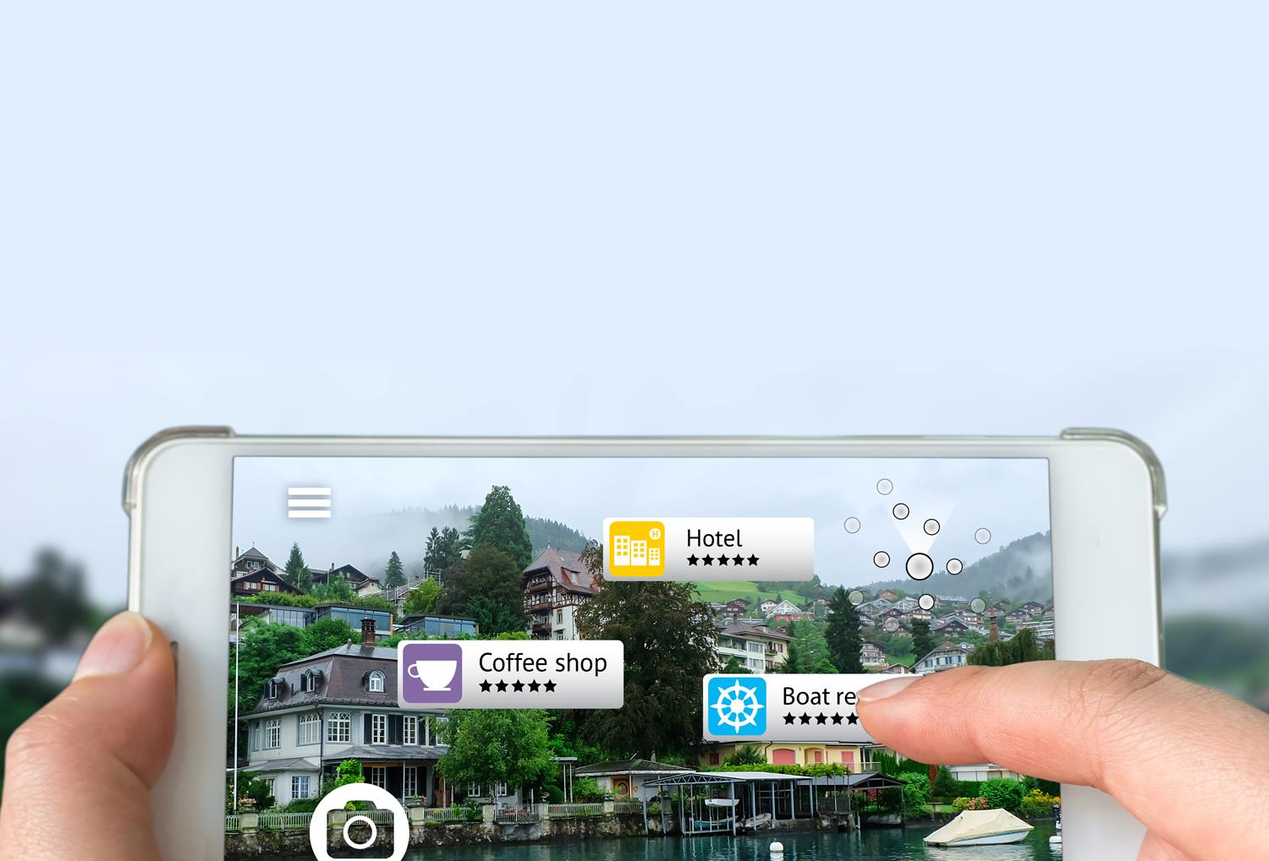
Augmented reality
By adding information to the world we can:
add reviews on shops and cafés as we see them
utilise a heads-up display when driving
or play Pokémon Go

Slide 10

Entrepreneurs & start-ups
It took just three people to create Snapchat
Bobby Murphy was the programmer who coded the app
Within four years the software was sending six billion videos per day
Most entrepreneurs can’t imagine having made it without a knowledge of IT and Computer Science

Slide 11

Big companies in the UK
Major international companies are present in the UK and looking for bright new talent
Google
Microsoft
Apple
Samsung
Facebook

Slide 12

A strong games industry
The UK is well known for its games development.
The following were all made in the UK:
Grand Theft Auto (Edinburgh)
Elite Dangerous (Cambridge)
Candy Crush (London)
Batman: Arkham (London)
Sonic Forces (Leamington Spa)
Burnout Paradise (Guildford)
Lara Croft (Derby)

Slide 13

Course content
The GCSE is assessed through two external exams
Each exam is worth 50%
There will be opportunity to program during the course (in python)
You will be given a variety of programming tasks to complete which will help you prepare for paper 2

Slide 14
What will I learn?
This GCSE will equip you with a range of transferable practical and theoretical skills:
Programming skills
An understanding of how computers and networks work
Knowledge of cyber-security and how hackers attack systems

Slide 15
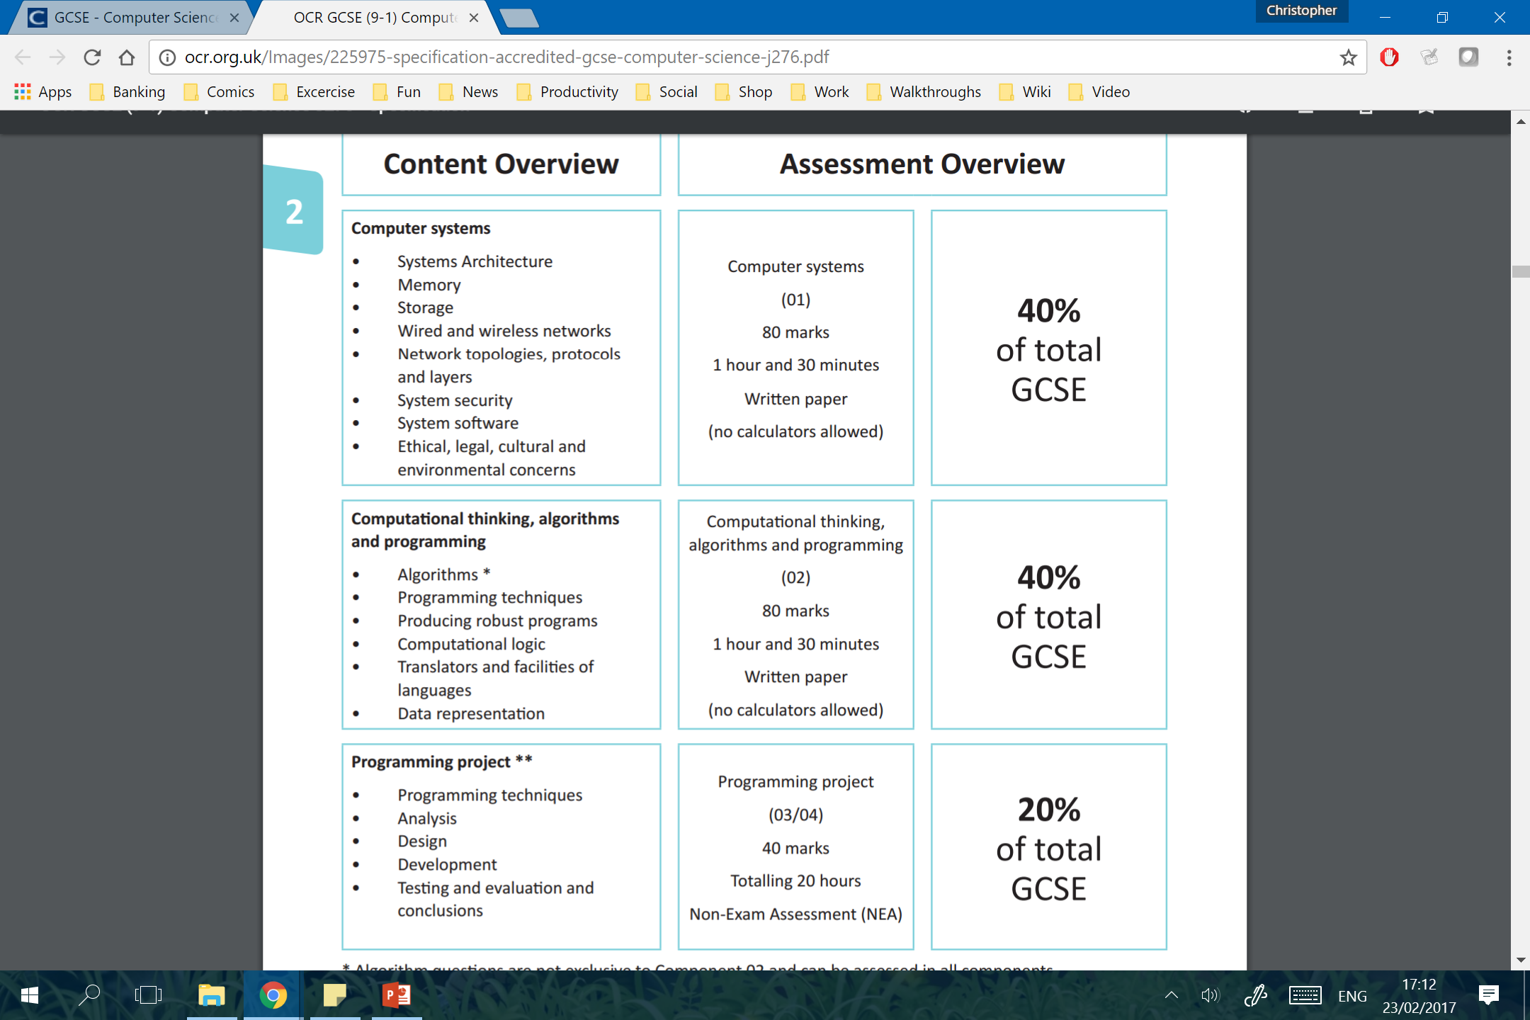
Paper 1 content
Worth 50% towards final grade

Slide 16
Paper 2 content
Worth 50% towards final grade

Slide 17
Equip yourself for success
IT, programming and computer services have an ever growing number of jobs in the UK
712,000
674,000
640,000
607,000
558,000
574,000
483,000
2011
2012
2013
2014
2015
2016
2017

Slide 18



Slide 19

Big careers in…

