Slide 1
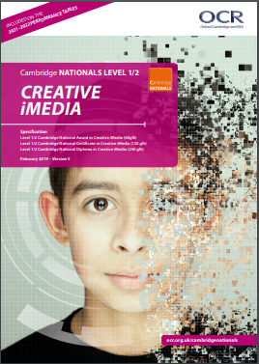
CREATIVE
I-MEDIA
Creative iMedia
OCR CAMBRIDGE NATIONALS (CERTIFICATE)

Slide 2
What is creative i-media?
Cambridge Nationals in Creative iMedia are media sector-focused, including film, television, web development, gaming and animation, and have IT at their heart.
Our Cambridge National in Creative iMedia will inspire and equip students with the confidence to use skills that are relevant to the digital media sector and more widely. They’ll design, plan, create and review digital media products to meet client and target audience demands.
A Cambridge National qualification is the equivalent to a GCSE and gives you the chance to put your learning into practice, develop skills and build your confidence.

Slide 3
As part of the Cambridge National, you might cover:
How media products get their meaning across, create impact and appeal to people
• how to create original digital graphics for specific audiences
• designing and creating original characters and comics
• creating, testing and making websites.
The Course incudes 2 coursework units and an exam. Two of which are mandatory and one optional decided by the teacher annually.

Slide 4
Mandatory Units
R093: Creative iMedia in the media industry - 1 hour 15 minutes written paper, OCR set and marked:
Media industry sectors and products
Job roles in the media industry
Factors influencing product design
How style, content and layout are linked to the purpose
Client requirements and how they are defined
Audience demographics and segmentation
Sources of research and types of research data
Media codes used to convey meaning, create impact and/or engage audiences
Pre-production planning
Work planning
Documents used to support ideas generation
Documents used to design and plan media products
The legal issues that affect media Distribution considerations
Distribution platforms and media to reach audiences
Properties and formats of media files

Slide 5
Mandatory Units
R094: Visual identity and digital graphics - Non Examined Assessment (coursework)
Centre-assessed tasks, OCR moderated:
Purpose, elements and design of visual identity
Graphic design and conventions
Properties of digital graphics and use of assets
Techniques to plan visual identity and digital graphics
Create visual identity and digital graphics
Tools and techniques of imaging editing software used to create digital graphics
Technical skills to source, create and prepare assets for use within digital graphics
Techniques to save and export visual identity and digital graphics

Slide 6
Optional Unit
One optional unit, internally marked and moderated by OCR.
Briefs change annually, set by OCR and the teacher chooses one which best suits students skills and needs at the time.
This could include:
building a website
visual imaging,
an interactive media product,
characters and their comic and more…

Slide 7
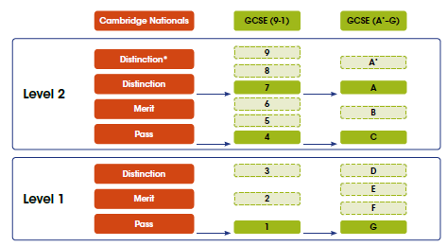
Grading
All results are awarded on the following scale:

Slide 8
Building futures through practical skills.
Software skills
You’ll develop a range of skills to help you succeed not only in the workplace but in other subjects too. These skills include:
• Analytical skills
• Digital presentation skills
• Creative thinking
• Problem solving
• Research and planning.
No matter what you progress on to – the skills you’ll learn from a Cambridge National will prepare you for the future.
Photoshop
RocketCake (websites)
Microsoft office

Slide 9
Possible careers and future education
Cambridge Nationals in Creative iMedia are media-sector focused, including film, television, web development, gaming and animation, and have IT at their heart. As a worker of the future, the ability to analyse and design systems that are used in the workplace, the ability to see relationships and the broader perspective, to develop your project management skills and understand the need for team management will all be important and marketable skills.
This qualification is useful to students intending to follow Level 3 courses in media and IT. Examples include Cambridge Technical IT or Media courses, Media Studies and the Apprenticeship Framework.

Slide 10
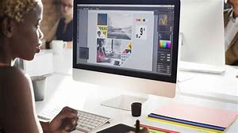
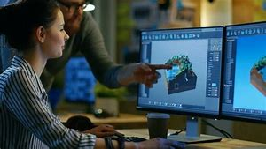
Possible careers
Graphics designer
Web developer
Web content manager
Social media manager
PR executive
Media planner
Multimedia specialist
Advertising
UX designer
Editorial assistant
Publishing
Game designer
Game developer
Interior designer

Slide 11
Is this course for you?
If you are creative and want to apply your creative side using technology, then this would be a great course for you.
There is only 1 exam, so it is a more of a vocational subject. If you are better and completing coursework and assignments and putting the time and effort into your coursework, then this would be a good choice for you.

